Slide 1

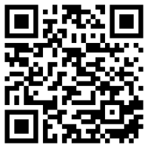

Introduction to clustering models by using R and tidymodels
Join the chat at https://aka.ms/LearnLiveTV
Carlotta Castelluccio
Follow along with these modules at https://aka.ms/learnlive-20220923A
Cloud advocate Microsoft
@carlottacaste
Jasleen Sondhi
Aspiring Data Scientist, Microsoft Student Ambassador
@jasleen101010
Notes:
GET EXCITED
High energy. Welcome the audience and each other to this Learn Live
Introduce yourselves.
Small amount of cross-talk.
Jasleen will start, introducing session and Carlotta.
Carlotta introduces Jasleen.
Link to published modules on Learn:
https://docs.microsoft.com/en-us/learn/modules/plan-resource-requirements
https://docs.microsoft.com/en-us/learn/modules/configure-azure-cosmos-db-sql-api

Slide 2

Say hi to our moderator!
Olanrewaju Oyinbooke
Senior Cloud Advocate
Microsoft
@theoyinbooke
Notes:
Jasleen

Slide 3

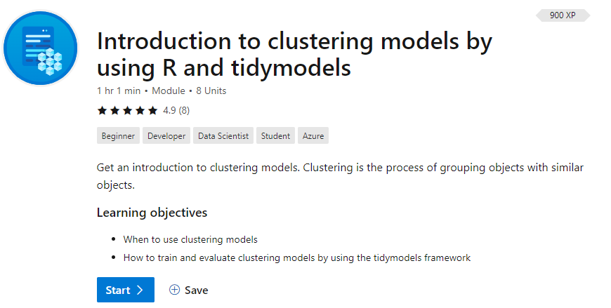
/learn
https://aka.ms/learnlive-20220923A
Complete interactive learning exercises, watch videos, and practice and apply your new skills.
Notes:
Introduce the module
Jasleen

Slide 4

Learning objective
What is clustering
Evaluate different types of clustering
How to train and evaluate clustering models in the tidymodels framework
Notes:
Our learning objectives for today are
Carlotta

Slide 5
Introduction

Slide 6
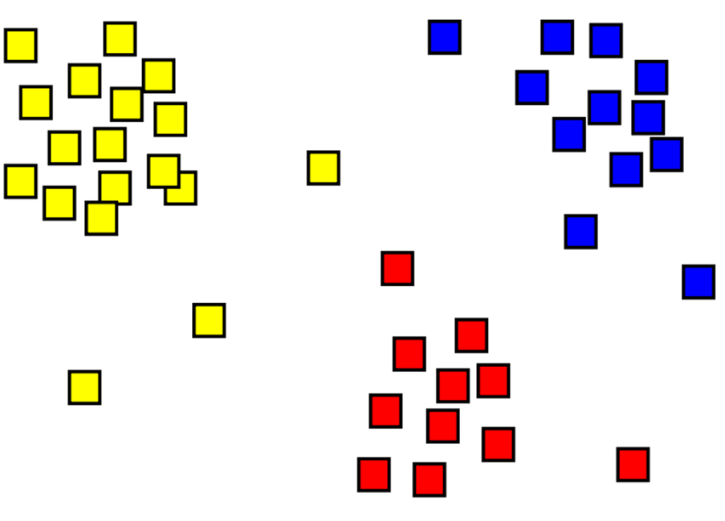
What is clustering?
Clustering is the process of grouping objects into clusters, based on similarities in their features.
This is an example of unsupervised machine learning.
Notes:
Clustering is the process of grouping objects with similar objects. For example, the following image shows a collection of 2D coordinates that have been clustered into three categories - top left (yellow), bottom (red), and top right (blue).
Clustering, unlike the technique called classification, is considered an unsupervised method of grouping, in which training is done without labels. Clustering models identify examples that have a similar collection of features. In the preceding image, examples that are in a similar location are grouped together.
Clustering is common and useful for exploring new data, where patterns between data points, such as high-level categories, are not yet known. It's used in many fields that need to automatically label complex data, including analysis of social networks, brain connectivity, and spam filtering.
Jasleen

Slide 7
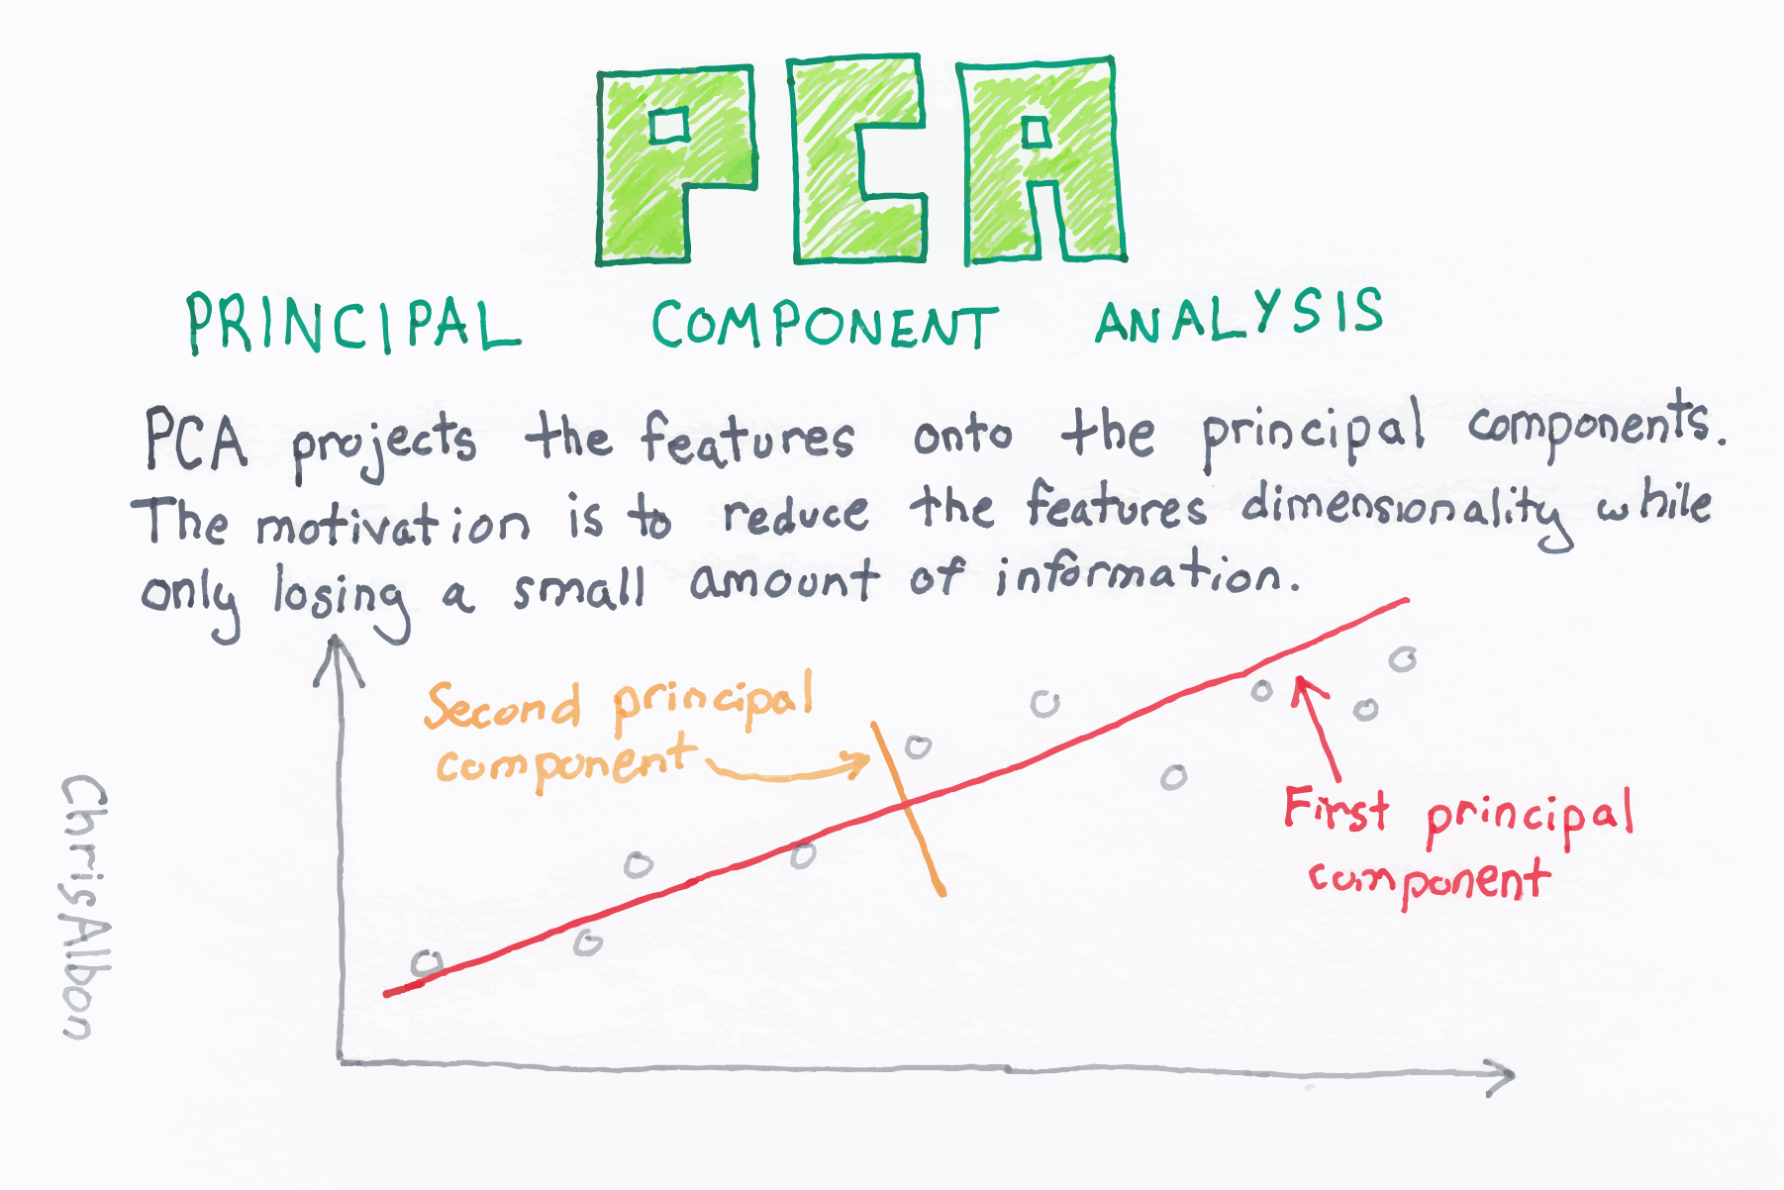
Preparing data with PCA
Principal component analysis (PCA) is a dimension reduction method that aims at reducing the feature space. Most of the information or variability in the dataset can then be explained by using fewer uncorrelated features.
Using PCA, you translate the n-dimensional feature values into two-dimensional coordinates.
Artwork by @chris_albon
Notes:
Carlotta
In real life scenario, you’ll find yourself working with quite big dataset with n columns (or features) that you could interpret (in the case of unsupervised learning) as coordinates, describing each item’s location into a n-dimensional space. Now, a n dimensional space is difficult to handle in a 3-dimension world, and it’s even harder to visualize it into a 2 dimensional plot. That’s why, to prepare your data for clustering, we could rely on a mathematical technique called principal component analysis (PCA) to analyze the relationships between the features, and to summarize each observation as coordinates for two principal components. In other words, we translate the n-dimensional feature values into two-dimensional and uncorrelated coordinates, able to explain most of the information or variability of our dataset.

Slide 8
Evaluate different types of clustering

Slide 9
Evaluate different types of clustering
There are multiple algorithms you can use for clustering.
The best-known ones are:
K-Means Clustering
Hierarchical clustering
Notes:
There are multiple algorithms you can use for clustering. Perhaps the two best-known approaches are called K-means clustering and hierarchical clustering.
Jasleen cover from 11 to 17 + kmean demo

Slide 10

K-means clustering
Notes:
The algorithm we previously used to approximate the number of clusters in our dataset is called K-means. Let's get to the finer details.
The basic algorithm has the following steps:
Specify the number of clusters to be created (this is done by the data scientist). Taking the flowers example from the previous unit, this means deciding how many clusters you want to use to group the flowers.
The algorithm randomly selects K observations from the dataset to serve as the initial centers for the clusters (that is, centroids).
Each of the remaining observations (in this case, flowers) is assigned to its closest centroid.
The new mean of each cluster is computed, and the centroid is moved to the mean.
Now that the centers have been recalculated, every observation is checked again to see if it might be closer to a different cluster. All the objects are reassigned again by using the updated cluster means. The cluster assignment and centroid update steps are iteratively repeated until the cluster assignments stop changing (that is, when convergence is achieved). Typically, the algorithm terminates when each new iteration results in negligible movement of centroids and the clusters become static.
Note that due to randomization of the initial K observations used as the starting centroids, we can get slightly different results each time we apply the procedure. For this reason, most algorithms use several random starts and choose the iteration with the lowest within cluster sum of squares (WCSS). As such, it's strongly recommended to always run K-means with several values of nstart.
So, training usually involves multiple iterations, reinitializing the centroids each time, and the model with the best (lowest) WCSS is selected. The following animation shows this process:

Slide 11
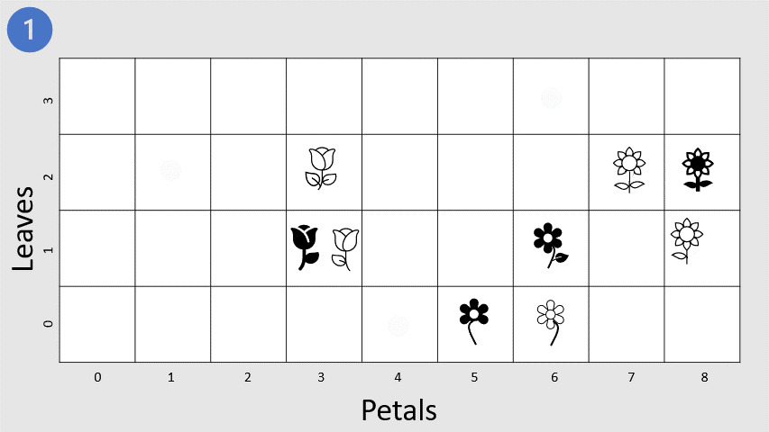
K-Means clustering
1. The data scientist specifies the number K of clusters.
Notes:
The algorithm we previously used to approximate the number of clusters in our data set is called K-Means. Let's get to the finer details, shall we?
The basic algorithm has the following steps:
Specify the number of clusters to be created (this is done by the data scientist). Taking the flowers example we used at the beginning of the lesson, this means deciding how many clusters you want to use to group the flowers.
Next, the algorithm randomly selects K observations from the data set to serve as the initial centers for the clusters (that is, centroids).
Each of the remaining observations (in this case flowers) are assigned to its closest centroid.
The new means of each cluster is computed and the centroid is moved to the mean.
Now that the centers have been recalculated, every observation is checked again to see if it might be closer to a different cluster. All the objects are reassigned again using the updated cluster means. The cluster assignment and centroid update steps are iteratively repeated until the cluster assignments stop changing (that is, when convergence is achieved). Typically, the algorithm terminates when each new iteration results in negligible movement of centroids and the clusters become static.
Note that due to randomization of the initial K observations used as the starting centroids, we can get slightly different results each time we apply the procedure. For this reason, most algorithms use several random starts and choose the iteration with the lowest within cluster sum of squares (WCSS). As such, it's strongly recommended to always run K-Means with several values of nstart to avoid an undesirable local optimum.
So, training usually involves multiple iterations, reinitializing the centroids each time, and the model with the best (lowest) WCSS is selected. The following animation shows this process:

Slide 12
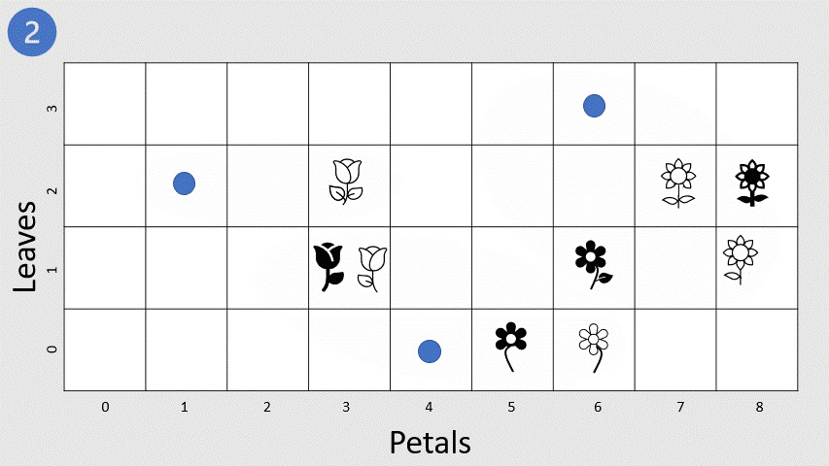
K-Means clustering
2. The algorithm randomly selects K observations as the initial centroids for the clusters.
Notes:
The algorithm we previously used to approximate the number of clusters in our data set is called K-Means. Let's get to the finer details, shall we?
The basic algorithm has the following steps:
Specify the number of clusters to be created (this is done by the data scientist). Taking the flowers example we used at the beginning of the lesson, this means deciding how many clusters you want to use to group the flowers.
Next, the algorithm randomly selects K observations from the data set to serve as the initial centers for the clusters (that is, centroids).
Each of the remaining observations (in this case flowers) are assigned to its closest centroid.
The new means of each cluster is computed and the centroid is moved to the mean.
Now that the centers have been recalculated, every observation is checked again to see if it might be closer to a different cluster. All the objects are reassigned again using the updated cluster means. The cluster assignment and centroid update steps are iteratively repeated until the cluster assignments stop changing (that is, when convergence is achieved). Typically, the algorithm terminates when each new iteration results in negligible movement of centroids and the clusters become static.
Note that due to randomization of the initial K observations used as the starting centroids, we can get slightly different results each time we apply the procedure. For this reason, most algorithms use several random starts and choose the iteration with the lowest within cluster sum of squares (WCSS). As such, it's strongly recommended to always run K-Means with several values of nstart to avoid an undesirable local optimum.
So, training usually involves multiple iterations, reinitializing the centroids each time, and the model with the best (lowest) WCSS is selected. The following animation shows this process:

Slide 13
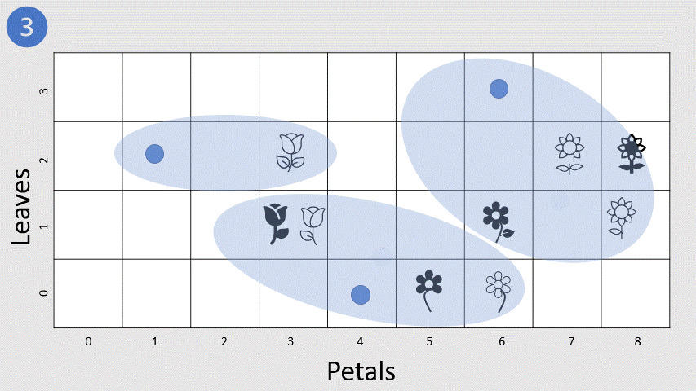
K-Means clustering
3. Each of the remaining observations are assigned to its closest centroid.
Notes:
The algorithm we previously used to approximate the number of clusters in our data set is called K-Means. Let's get to the finer details, shall we?
The basic algorithm has the following steps:
Specify the number of clusters to be created (this is done by the data scientist). Taking the flowers example we used at the beginning of the lesson, this means deciding how many clusters you want to use to group the flowers.
Next, the algorithm randomly selects K observations from the data set to serve as the initial centers for the clusters (that is, centroids).
Each of the remaining observations (in this case flowers) are assigned to its closest centroid.
The new means of each cluster is computed and the centroid is moved to the mean.
Now that the centers have been recalculated, every observation is checked again to see if it might be closer to a different cluster. All the objects are reassigned again using the updated cluster means. The cluster assignment and centroid update steps are iteratively repeated until the cluster assignments stop changing (that is, when convergence is achieved). Typically, the algorithm terminates when each new iteration results in negligible movement of centroids and the clusters become static.
Note that due to randomization of the initial K observations used as the starting centroids, we can get slightly different results each time we apply the procedure. For this reason, most algorithms use several random starts and choose the iteration with the lowest within cluster sum of squares (WCSS). As such, it's strongly recommended to always run K-Means with several values of nstart to avoid an undesirable local optimum.
So, training usually involves multiple iterations, reinitializing the centroids each time, and the model with the best (lowest) WCSS is selected. The following animation shows this process:

Slide 14
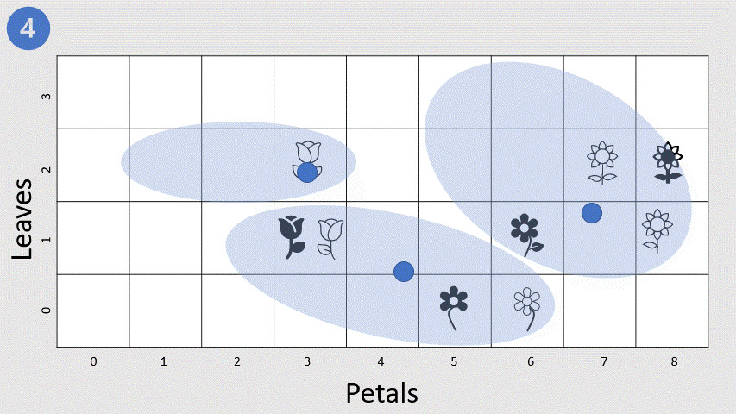
K-Means clustering
4. The new means of each cluster is computed and the centroid is moved to the mean.
Notes:
The algorithm we previously used to approximate the number of clusters in our data set is called K-Means. Let's get to the finer details, shall we?
The basic algorithm has the following steps:
Specify the number of clusters to be created (this is done by the data scientist). Taking the flowers example we used at the beginning of the lesson, this means deciding how many clusters you want to use to group the flowers.
Next, the algorithm randomly selects K observations from the data set to serve as the initial centers for the clusters (that is, centroids).
Each of the remaining observations (in this case flowers) are assigned to its closest centroid.
The new means of each cluster is computed and the centroid is moved to the mean.
Now that the centers have been recalculated, every observation is checked again to see if it might be closer to a different cluster. All the objects are reassigned again using the updated cluster means. The cluster assignment and centroid update steps are iteratively repeated until the cluster assignments stop changing (that is, when convergence is achieved). Typically, the algorithm terminates when each new iteration results in negligible movement of centroids and the clusters become static.
Note that due to randomization of the initial K observations used as the starting centroids, we can get slightly different results each time we apply the procedure. For this reason, most algorithms use several random starts and choose the iteration with the lowest within cluster sum of squares (WCSS). As such, it's strongly recommended to always run K-Means with several values of nstart to avoid an undesirable local optimum.
So, training usually involves multiple iterations, reinitializing the centroids each time, and the model with the best (lowest) WCSS is selected. The following animation shows this process:

Slide 15
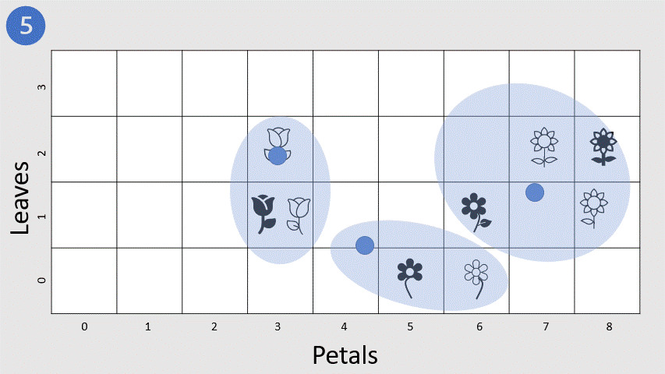
K-Means clustering
5. The cluster assignment and centroid update steps are iteratively repeated until the cluster assignments stop changing.
Notes:
The algorithm we previously used to approximate the number of clusters in our data set is called K-Means. Let's get to the finer details, shall we?
The basic algorithm has the following steps:
Specify the number of clusters to be created (this is done by the data scientist). Taking the flowers example we used at the beginning of the lesson, this means deciding how many clusters you want to use to group the flowers.
Next, the algorithm randomly selects K observations from the data set to serve as the initial centers for the clusters (that is, centroids).
Each of the remaining observations (in this case flowers) are assigned to its closest centroid.
The new means of each cluster is computed and the centroid is moved to the mean.
Now that the centers have been recalculated, every observation is checked again to see if it might be closer to a different cluster. All the objects are reassigned again using the updated cluster means. The cluster assignment and centroid update steps are iteratively repeated until the cluster assignments stop changing (that is, when convergence is achieved). Typically, the algorithm terminates when each new iteration results in negligible movement of centroids and the clusters become static.
Note that due to randomization of the initial K observations used as the starting centroids, we can get slightly different results each time we apply the procedure. For this reason, most algorithms use several random starts and choose the iteration with the lowest within cluster sum of squares (WCSS). As such, it's strongly recommended to always run K-Means with several values of nstart to avoid an undesirable local optimum.
So, training usually involves multiple iterations, reinitializing the centroids each time, and the model with the best (lowest) WCSS is selected. The following animation shows this process:

Slide 16
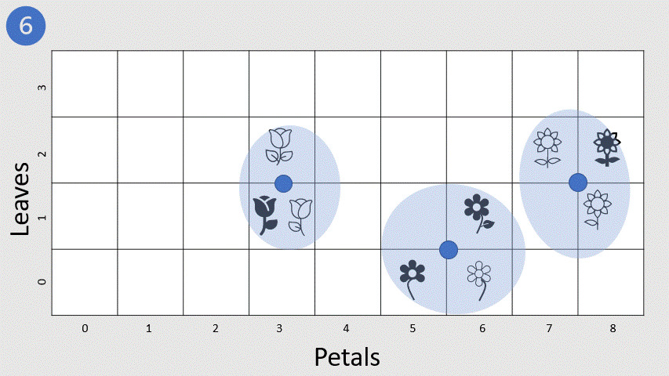
K-Means clustering
6. Convergence is achieved. It’s strongly recommended to run K-Means with several values of nstart to avoid an undesirable local optimum.
Notes:
The algorithm we previously used to approximate the number of clusters in our data set is called K-Means. Let's get to the finer details, shall we?
The basic algorithm has the following steps:
Specify the number of clusters to be created (this is done by the data scientist). Taking the flowers example we used at the beginning of the lesson, this means deciding how many clusters you want to use to group the flowers.
Next, the algorithm randomly selects K observations from the data set to serve as the initial centers for the clusters (that is, centroids).
Each of the remaining observations (in this case flowers) are assigned to its closest centroid.
The new means of each cluster is computed and the centroid is moved to the mean.
Now that the centers have been recalculated, every observation is checked again to see if it might be closer to a different cluster. All the objects are reassigned again using the updated cluster means. The cluster assignment and centroid update steps are iteratively repeated until the cluster assignments stop changing (that is, when convergence is achieved). Typically, the algorithm terminates when each new iteration results in negligible movement of centroids and the clusters become static.
Note that due to randomization of the initial K observations used as the starting centroids, we can get slightly different results each time we apply the procedure. For this reason, most algorithms use several random starts and choose the iteration with the lowest within cluster sum of squares (WCSS). As such, it's strongly recommended to always run K-Means with several values of nstart to avoid an undesirable local optimum.
So, training usually involves multiple iterations, reinitializing the centroids each time, and the model with the best (lowest) WCSS is selected. The following animation shows this process:

Slide 17
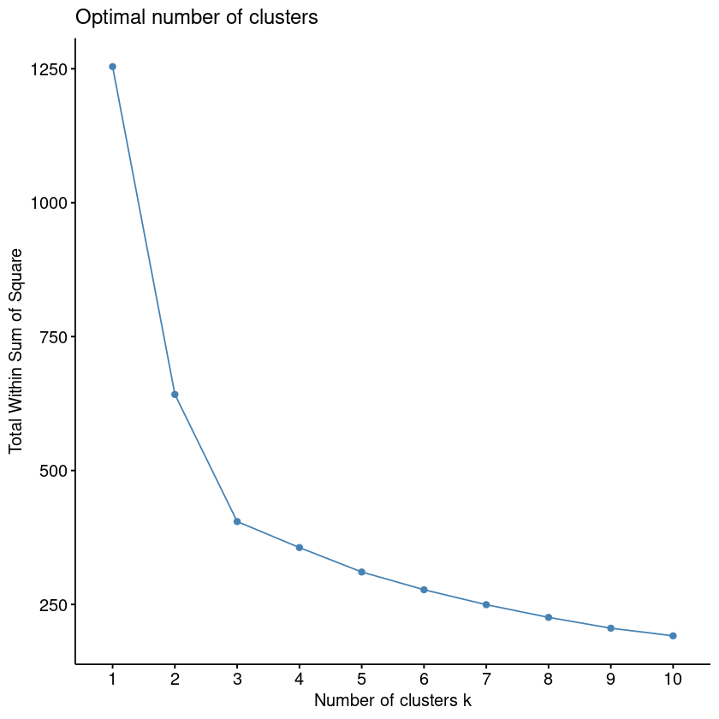
Within cluster sum of squares (WCSS)
Without knowing class labels, how do you know how many clusters to separate your data into?
One way is to create a series of clustering models with an incrementing number of clusters and then measure how tightly the data points are grouped within each cluster.
Notes:
Here's one of the fundamental problems with clustering: without knowing class labels, how do you know how many clusters to separate your data into?
Although hierarchical clustering doesn't require you to pre-specify the number of clusters, you still need to specify the number of clusters to extract.
One way is to use a data sample to create a series of clustering models with an incrementing number of clusters. Then you can measure how tightly the data points are grouped within each cluster. A metric often used to measure this tightness is the within cluster sum of squares (WCSS), with lower values meaning that the data points are closer. You can then plot the WCSS for each model.
Essentially, WCSS measures the variability of the observations within each cluster.

Slide 18
Demo: K-means clustering

Slide 19
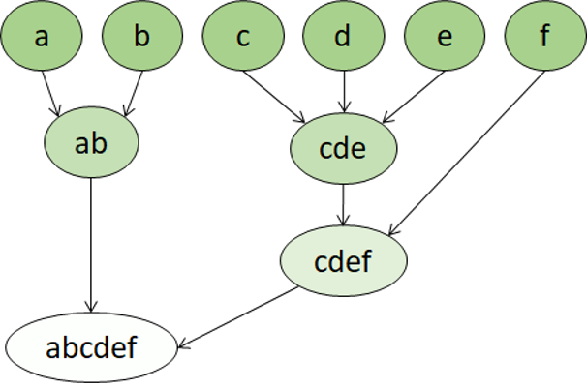
Hierarchical clustering
The clusters belong to a larger group, which belong to even larger groups, and so on.
Data points can be clusters in differing degrees of precision: with a large number of very small and precise groups, or a small number of larger groups.
Notes:
The first step in K-means clustering is the data scientist specifying the number of clusters (K) to partition the observations into. Hierarchical clustering, on the other hand, doesn't require the number of clusters to be defined in advance.
In hierarchical clustering, the clusters themselves belong to a larger group, which belong to even larger groups, and so on. The result is that data points can be clusters in differing degrees of precision: with a large number of very small and precise groups, or a small number of larger groups.
For example, if we apply clustering to the meanings of words, we might get a group containing adjectives specific to emotions (such as angry or happy). This group might, in turn, belong to a group containing all human-related adjectives (such as happy, handsome, or young). And this group might belong to an even higher group, containing all adjectives (such as happy, green, handsome, or hard).
Hierarchical clustering is useful not only for breaking data into groups, but also for understanding the relationships between these groups. This method can sometimes provide more interpretable results than non-hierarchical approaches. The major drawback, however, is that hierarchical clustering can take much longer to compute than simpler approaches. You might find the method unsuitable for large datasets.
Carlotta covers from 20 to 25 + hierarchical demo

Slide 20
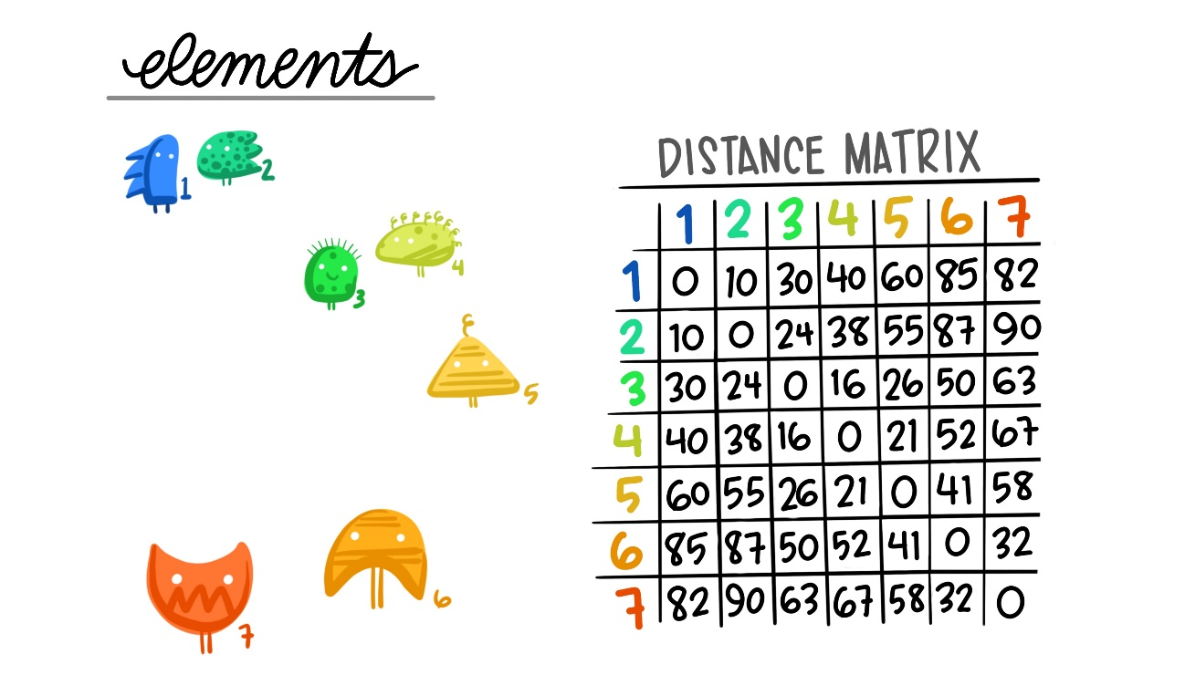

Hierarchical clustering: agglomerative clustering
The linkage distances between each of the data points is computed.
Artwork by @allison_horst
Notes:
Hierarchical clustering creates clusters by either a divisive method or an agglomerative method. The divisive method is a top-down approach, starting with the entire dataset and then finding partitions in a stepwise manner. Agglomerative clustering is a bottom-up approach. In this lab, you will work with agglomerative clustering, commonly referred to as AGNES (AGglomerative NESting), which roughly works as follows:
The linkage distances between each of the data points is computed.
Points are clustered pairwise with their nearest neighbor.
Linkage distances between the clusters are computed.
Clusters are combined pairwise into larger clusters.
Steps 3 and 4 are repeated until all data points are in a single cluster.
A fundamental question in hierarchical clustering is: how do we measure the dissimilarity between two clusters of observations? You can compute this in a number of ways:
Ward's minimum variance method minimizes the total within-cluster variance. At each step, the pair of clusters with the smallest between-cluster distance are merged. It tends to produce more compact clusters.
Average linkage uses the mean pairwise distance between the members of the two clusters. It can vary in the compactness of the clusters it creates.
Complete or maximal linkage uses the maximum distance between the members of the two clusters. It tends to produce clusters that are compact contours by their borders, but they are not necessarily compact inside.

Slide 21
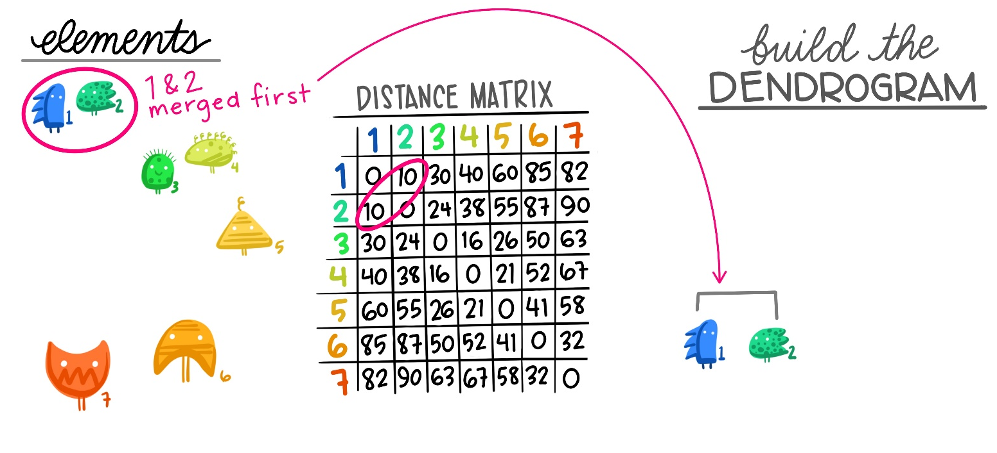

Hierarchical clustering: agglomerative clustering
2. Points are clustered pairwise with their nearest neighbor.
Artwork by @allison_horst
Notes:
Hierarchical clustering creates clusters by either a divisive method or an agglomerative method. The divisive method is a top-down approach, starting with the entire dataset and then finding partitions in a stepwise manner. Agglomerative clustering is a bottom-up approach. In this lab, you will work with agglomerative clustering, commonly referred to as AGNES (AGglomerative NESting), which roughly works as follows:
The linkage distances between each of the data points is computed.
Points are clustered pairwise with their nearest neighbor.
Linkage distances between the clusters are computed.
Clusters are combined pairwise into larger clusters.
Steps 3 and 4 are repeated until all data points are in a single cluster.
A fundamental question in hierarchical clustering is: how do we measure the dissimilarity between two clusters of observations? You can compute this in a number of ways:
Ward's minimum variance method minimizes the total within-cluster variance. At each step, the pair of clusters with the smallest between-cluster distance are merged. It tends to produce more compact clusters.
Average linkage uses the mean pairwise distance between the members of the two clusters. It can vary in the compactness of the clusters it creates.
Complete or maximal linkage uses the maximum distance between the members of the two clusters. It tends to produce clusters that are compact contours by their borders, but they are not necessarily compact inside.

Slide 22

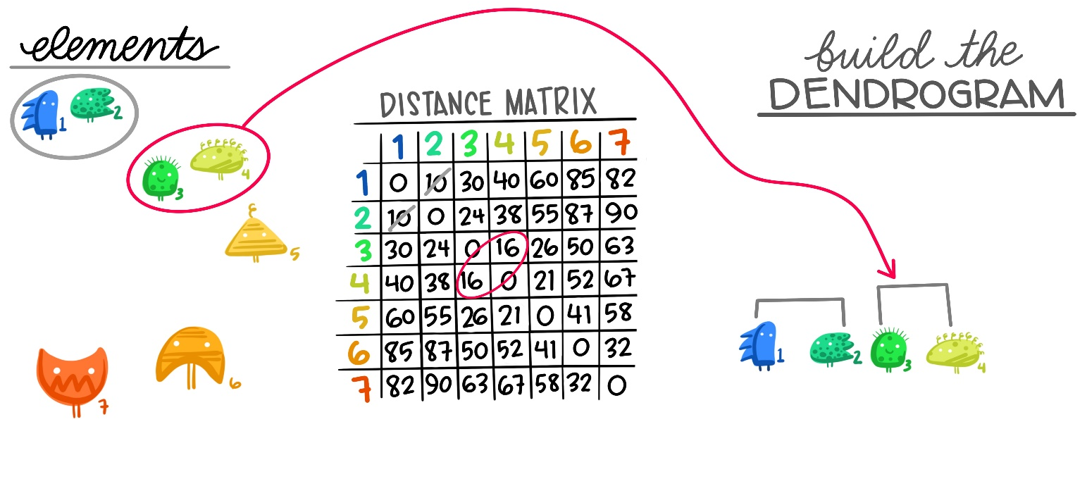
Hierarchical clustering: agglomerative clustering
3. Linkage distances between the clusters are computed.
Artwork by @allison_horst
Notes:
Hierarchical clustering creates clusters by either a divisive method or an agglomerative method. The divisive method is a top-down approach, starting with the entire dataset and then finding partitions in a stepwise manner. Agglomerative clustering is a bottom-up approach. In this lab, you will work with agglomerative clustering, commonly referred to as AGNES (AGglomerative NESting), which roughly works as follows:
The linkage distances between each of the data points is computed.
Points are clustered pairwise with their nearest neighbor.
Linkage distances between the clusters are computed.
Clusters are combined pairwise into larger clusters.
Steps 3 and 4 are repeated until all data points are in a single cluster.
A fundamental question in hierarchical clustering is: how do we measure the dissimilarity between two clusters of observations? You can compute this in a number of ways:
Ward's minimum variance method minimizes the total within-cluster variance. At each step, the pair of clusters with the smallest between-cluster distance are merged. It tends to produce more compact clusters.
Average linkage uses the mean pairwise distance between the members of the two clusters. It can vary in the compactness of the clusters it creates.
Complete or maximal linkage uses the maximum distance between the members of the two clusters. It tends to produce clusters that are compact contours by their borders, but they are not necessarily compact inside.

Slide 23
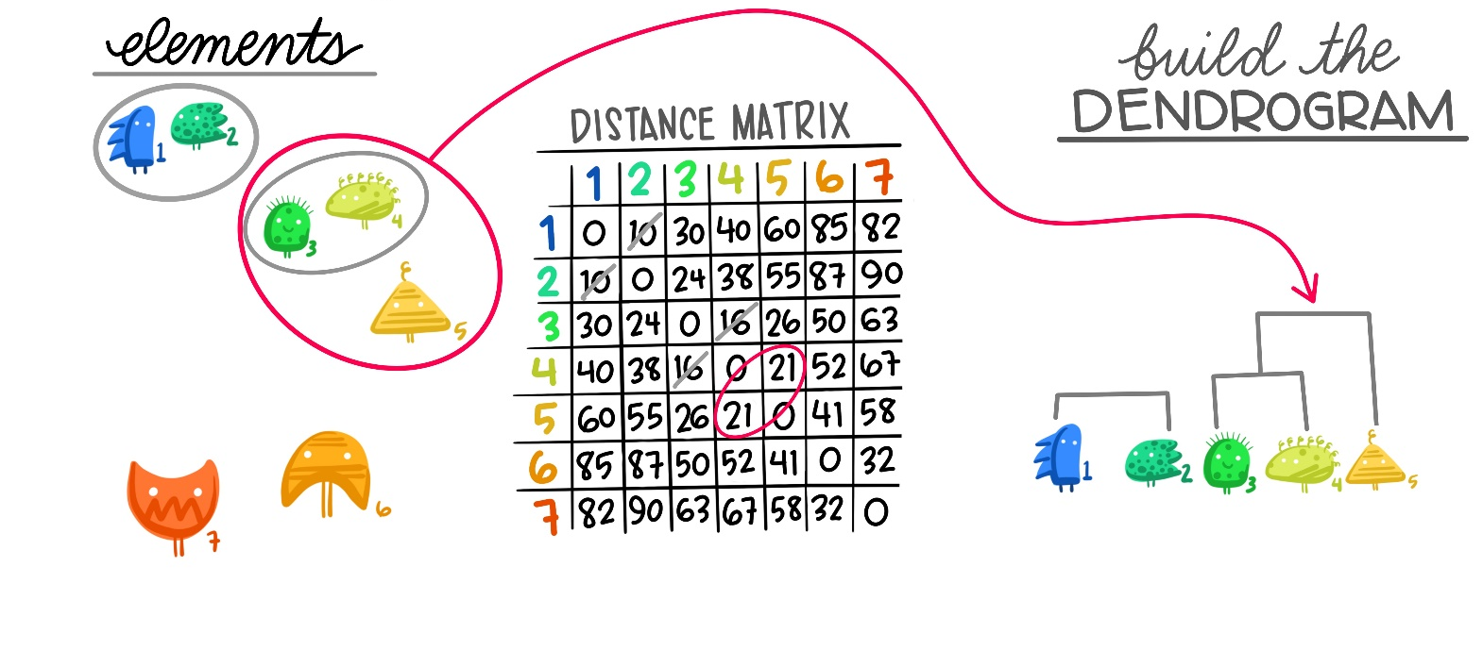

Hierarchical clustering: agglomerative clustering
4. Clusters are combined pairwise into larger clusters.
Artwork by @allison_horst
Notes:
Hierarchical clustering creates clusters by either a divisive method or an agglomerative method. The divisive method is a top-down approach, starting with the entire dataset and then finding partitions in a stepwise manner. Agglomerative clustering is a bottom-up approach. In this lab, you will work with agglomerative clustering, commonly referred to as AGNES (AGglomerative NESting), which roughly works as follows:
The linkage distances between each of the data points is computed.
Points are clustered pairwise with their nearest neighbor.
Linkage distances between the clusters are computed.
Clusters are combined pairwise into larger clusters.
Steps 3 and 4 are repeated until all data points are in a single cluster.
A fundamental question in hierarchical clustering is: how do we measure the dissimilarity between two clusters of observations? You can compute this in a number of ways:
Ward's minimum variance method minimizes the total within-cluster variance. At each step, the pair of clusters with the smallest between-cluster distance are merged. It tends to produce more compact clusters.
Average linkage uses the mean pairwise distance between the members of the two clusters. It can vary in the compactness of the clusters it creates.
Complete or maximal linkage uses the maximum distance between the members of the two clusters. It tends to produce clusters that are compact contours by their borders, but they are not necessarily compact inside.

Slide 24
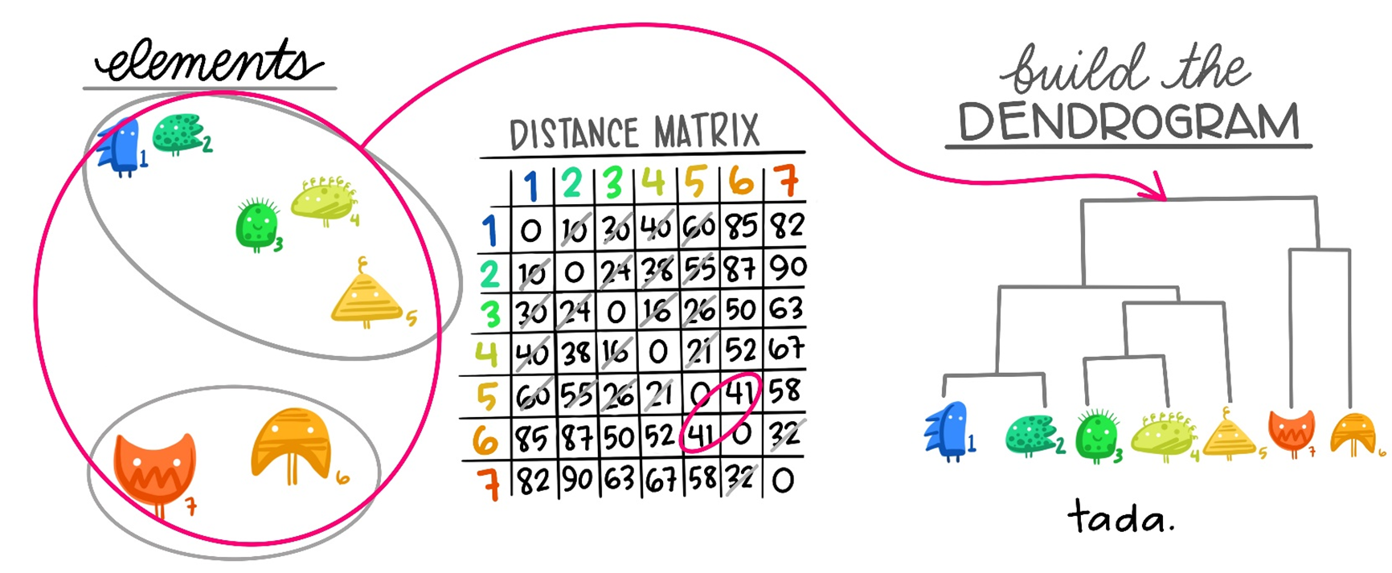

Hierarchical clustering: agglomerative clustering
5. Steps 3 and 4 are repeated until all data points are in a single cluster.
Artwork by @allison_horst
Notes:
Hierarchical clustering creates clusters by either a divisive method or an agglomerative method. The divisive method is a top-down approach, starting with the entire dataset and then finding partitions in a stepwise manner. Agglomerative clustering is a bottom-up approach. In this lab, you will work with agglomerative clustering, commonly referred to as AGNES (AGglomerative NESting), which roughly works as follows:
The linkage distances between each of the data points is computed.
Points are clustered pairwise with their nearest neighbor.
Linkage distances between the clusters are computed.
Clusters are combined pairwise into larger clusters.
Steps 3 and 4 are repeated until all data points are in a single cluster.
A fundamental question in hierarchical clustering is: how do we measure the dissimilarity between two clusters of observations? You can compute this in a number of ways:
Ward's minimum variance method minimizes the total within-cluster variance. At each step, the pair of clusters with the smallest between-cluster distance are merged. It tends to produce more compact clusters.
Average linkage uses the mean pairwise distance between the members of the two clusters. It can vary in the compactness of the clusters it creates.
Complete or maximal linkage uses the maximum distance between the members of the two clusters. It tends to produce clusters that are compact contours by their borders, but they are not necessarily compact inside.

Slide 25
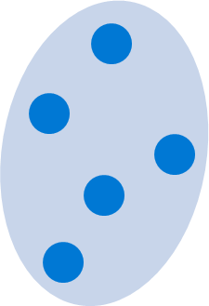
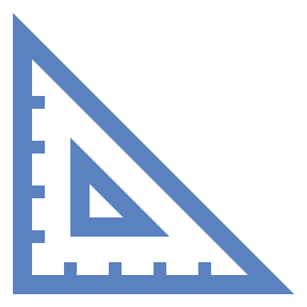
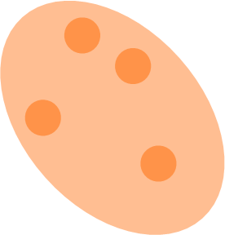
Measures of dissimilarity between clusters
Distance metrics:
Euclidian
Manhattan
Cosine similarity
Complete linkage
Average linkage
Ward’s linkage
Notes:
Carlotta
Dissimilarity methods:
Ward's minimum variance -> minimizes the total within-cluster variance.
Average linkage -> uses the mean pairwise distance between the members of the two clusters.
Complete or maximal linkage -> uses the maximum distance between the members of the two clusters.

Slide 26
Demo: K-means clustering vs hierarchical clustering

Slide 27

Knowledge Check
Notes:
Jasleen

Slide 28

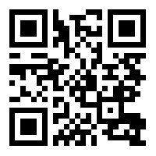
Question 1
K-means clustering is an example of which kind of machine learning?
Unsupervised machine learning.
Supervised machine learning.
Reinforcement learning.
Vote at
Vote at https://aka.ms/polls
Notes:
Explanation: That's correct. Clustering is a form of unsupervised machine learning in which the training data does not include known labels.
Jasleen asks 1st question to Carlotta

Slide 29
Question 2
You're using the built-in `kmeans()` function in R to train a K-means clustering model that groups observations into three clusters. How should you create the object of class `kmeans` to specify that you want to obtain three clusters?
kclust <- kmeans(nstart = 3)
kclust <- kmeans(iter.max = 3)
kclust <- kmeans(centers = 3)
Vote at
Vote at https://aka.ms/polls
Notes:
Explanation: That's correct. The `centers` parameter determines the number of clusters, k.
Carlotta asks Jasleen

Slide 30
Summary
What is clustering
Evaluate different types of clustering
How to train and evaluate clustering models in the tidymodels framework
Notes:
Jasleen

Slide 31
/learn
https://aka.ms/learnlive-20220923A
Complete interactive learning exercises, watch videos, and practice and apply your new skills.
Notes:
Introduce the module
Jasleen

Slide 32
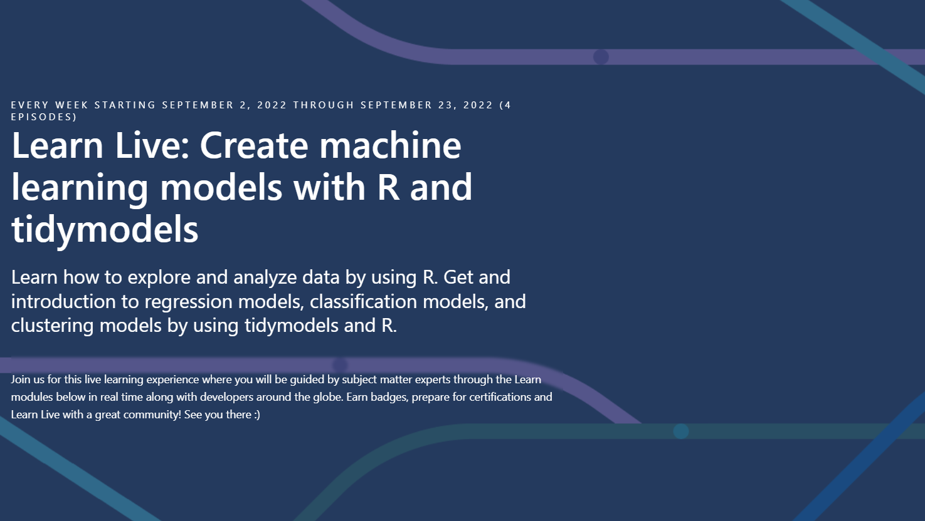
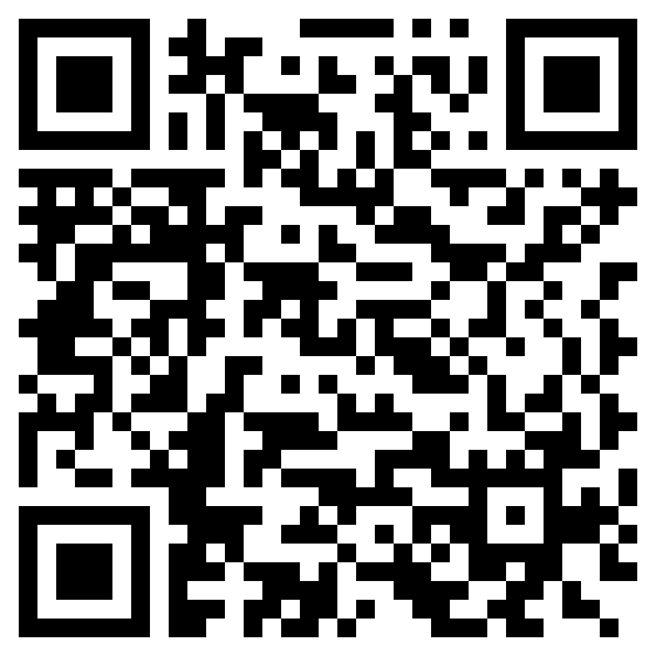
Rewatch the whole series
https://aka.ms/learnlive -machine-learning-r-tidymodels
Learn how to explore and analyze data by using R. Get and introduction to regression models, classification models, and clustering models by using tidymodels and R.
Notes:
Carlotta

